Slide 1
Mobile customer services management
Presented by: Md. Tofazzal Hosen (171442520)
Md. Mizanur Rahman (171442541)
Farzana kuddus(171442583)
Presented To: Supta Richard Philip
senior lecturer, Department of CSE
, City University Bangladesh

Slide 2
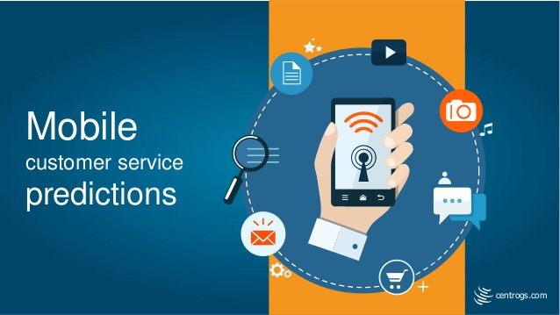
Introduction: With a growing number of consumers now viewing mobile devices as their primary means of communication with the contact center.
This provided customer to solved hardware related problem of mobile.
This also provides software related issue of mobile.
Its help customer to get warranty services which provide by mobile company.

Slide 3
How do mobile customer service apps work?
Mobile customer service apps provide an efficient and convenient way to find information, get answers and contact customer service,
Mobile customer service apps allow a company to transform its app from being purely transactional to providing cross-channel service conversations.
This enables customers to see the menus and prompts instantly rather than having to wait to hear them,
Customers also have the option to book a call-back either as soon as an agent is available or within a specified time window.

Slide 4

Economic Feasibility:
Businesses from all corners of the world, offering a ridiculous range of products, have begun migrating from the physical world of handing out leaflets, printing advertisements
And maybe that’s been the case in the past. But if you want to prepare for the future and start seeing the massive benefits right out the gate, you’ll need a mobile app.

Slide 5
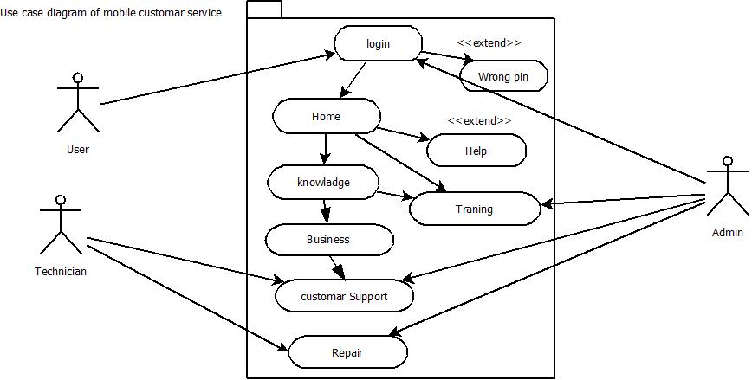
Use case diagram for mobile customer services

Slide 6
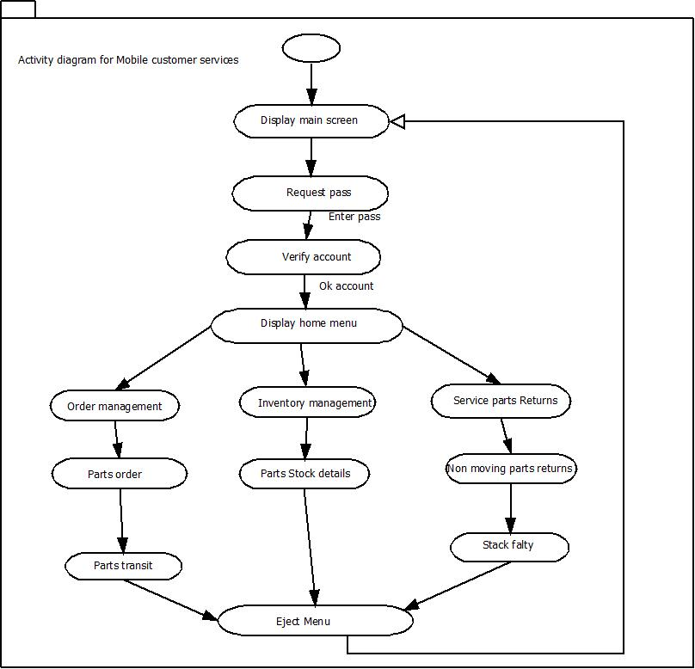
Activity diagram for mobile customer services

Slide 7
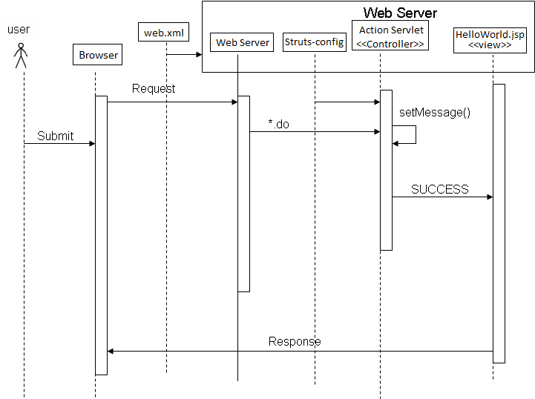
Sequential diagram for mobile customer services

Slide 8
THANK YOU

